Slide 1

Microsoft Project Blockbuster
Brendan M. Whittington

Slide 2
Summary
Our analysis shows an entry into the movie industry will need to come with a strong financial commitment and release strategy
There is a strong relationship between production costs and box office gross
There are key months where movies see the highest grosses
Audiences only marginally rate 3-D movies higher

Slide 3
Outline
Business Problem
Data & Methods
Results
Conclusion

Slide 4
Business Problem
Capital Allocation Decision
Timing Strategy
Creative / Genre Strategy

Slide 5
Data & Methods
Utilized data from IMDB and The Numbers
Looked at almost 4,000 movies among those over 200 3-D movies primarily since 2000
Focus was to include only movies during a similar cost of production period

Slide 6
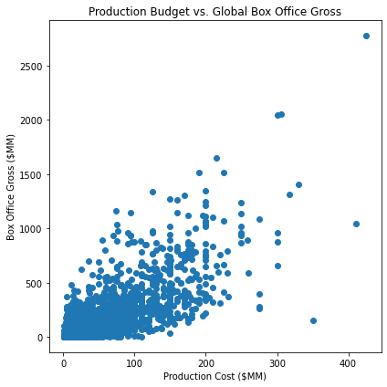
Results
There is a strong correlation between production budgets and the gross box office receipt.

Slide 7
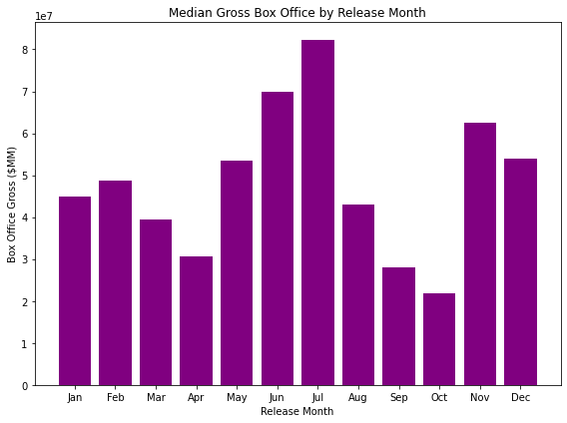
Results
There is strong seasonality in the movie release months. July is by far the most successful month whereas October is the worst.

Slide 8
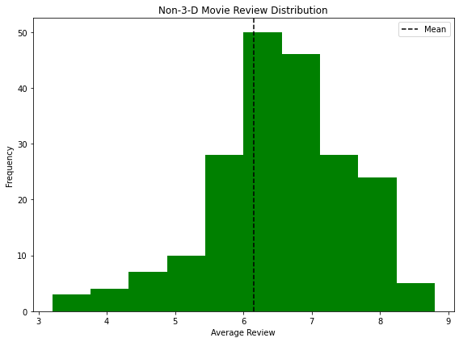
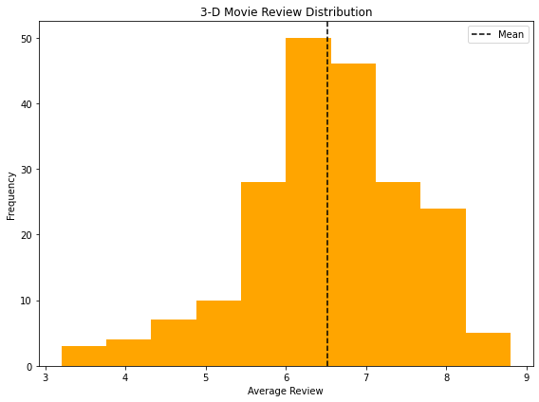
Results
The average movie that also has a 3-D release scores marginally higher than movies without the 3-D option.

Slide 9
Conclusion
Big budget movies tend to make more money than smaller ones
Microsoft should focus on making big budget movies
Movies show strong seasonality
Release movies in June/July and November/December
There is higher appeal toward 3-D
Microsoft should focus on making 3-D movies

Slide 10
Next Steps
Does “bigger is better” hold when including marketing budgets?
What are the returns on investments by month of release?
How much more money can one expect to make with a 3-D movie?

Slide 11
Thank You!
Email: brendanwhittington@gmail.com
GitHub: @Bmdubs88
LinkedIn: https://www.linkedin.com/in/brendanwhittington/

